Slide 1
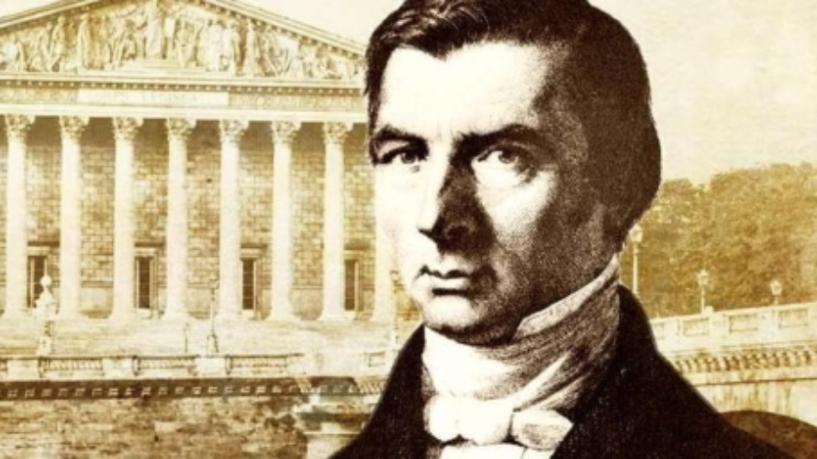

Slide 2


Slide 3
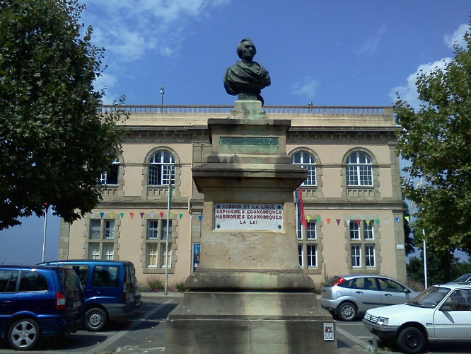

Slide 4
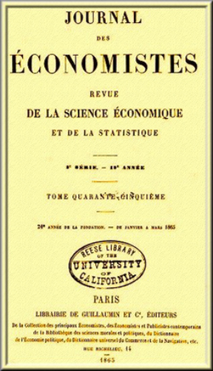

Slide 5
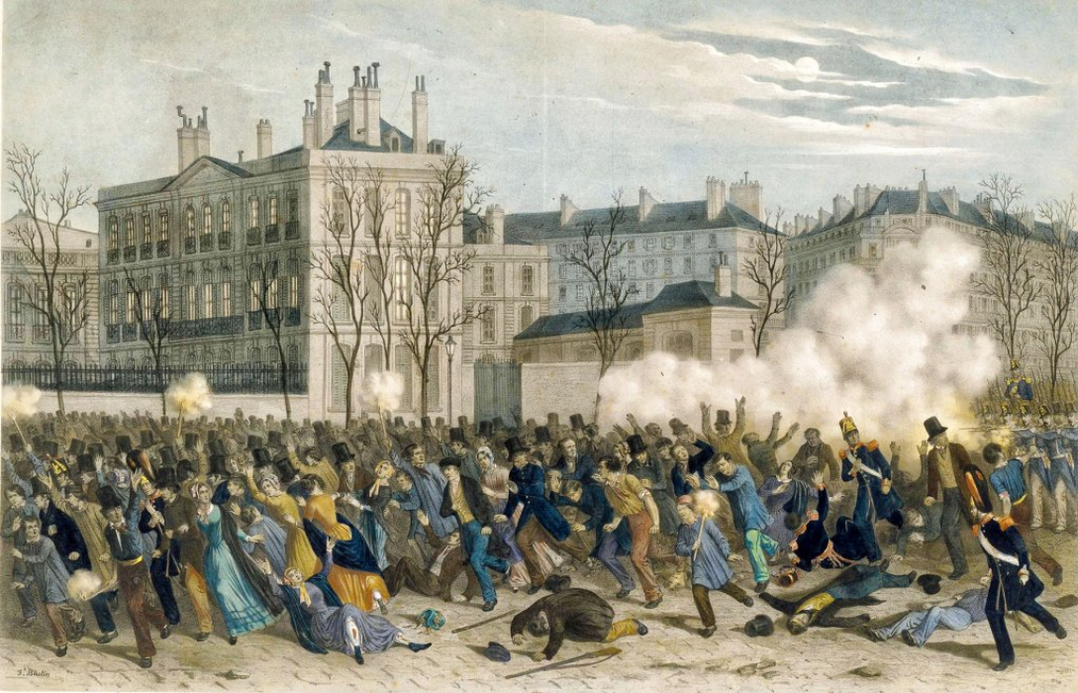

Slide 6
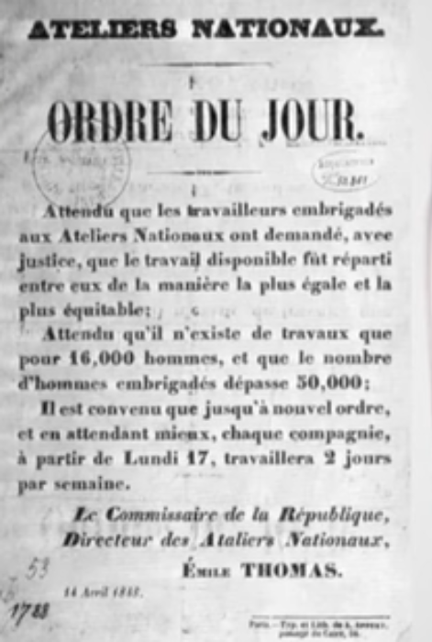

Slide 7
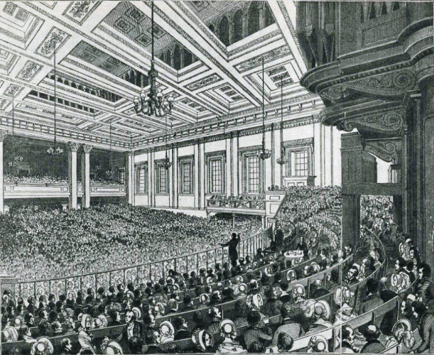

Slide 8
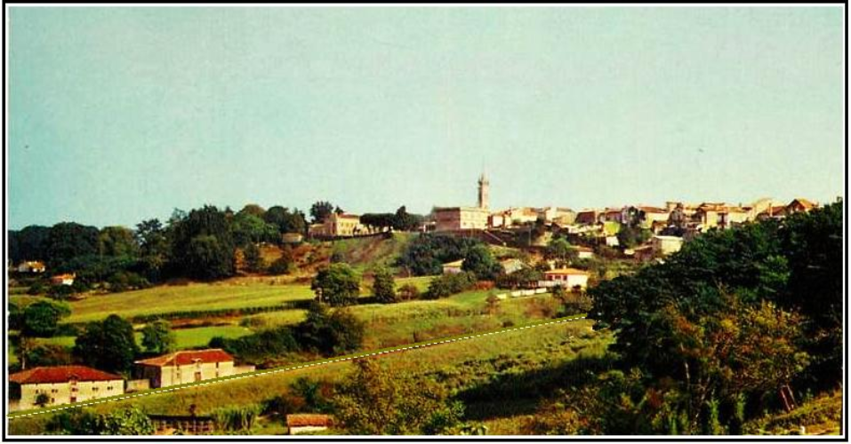

Slide 9
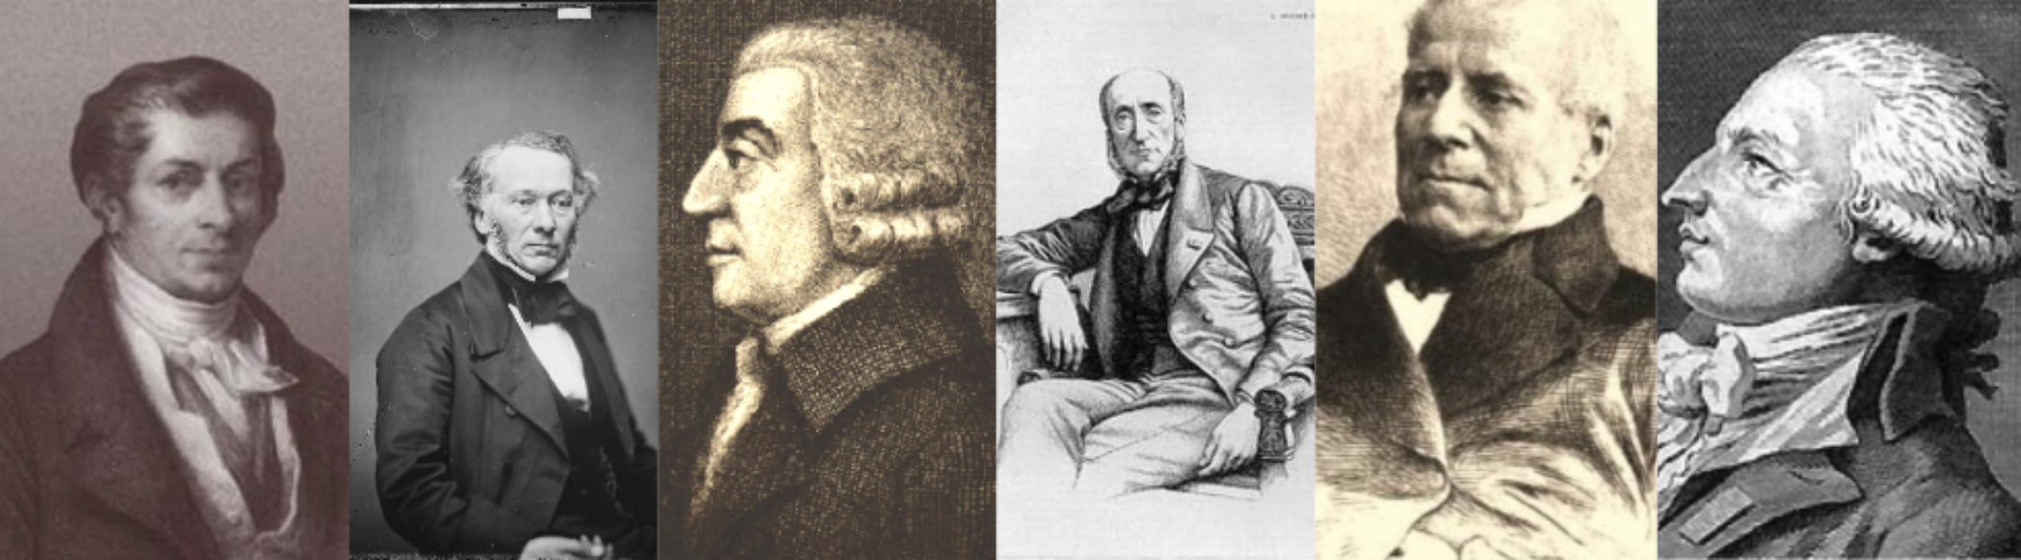

Slide 10
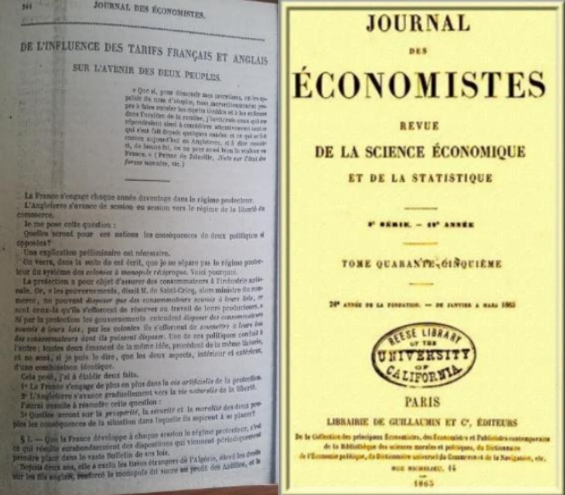

Slide 11


Slide 12
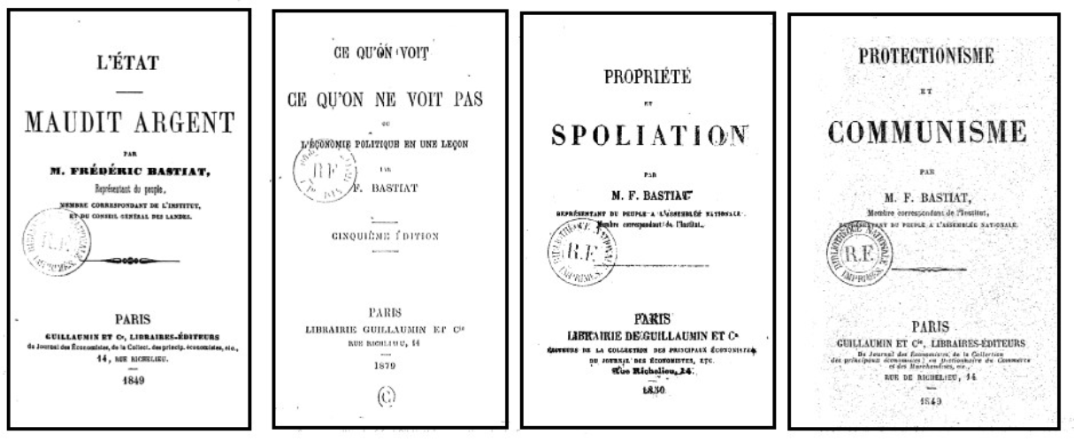

Slide 13
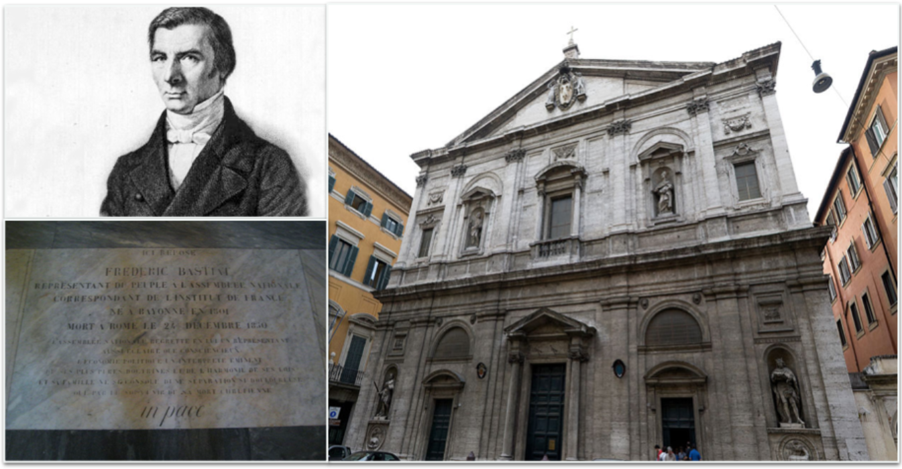

Slide 14
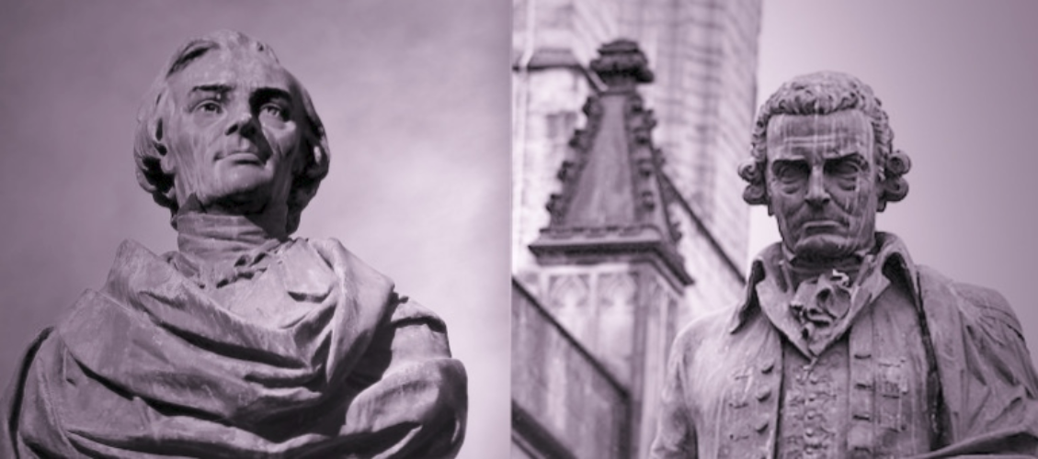

Slide 15
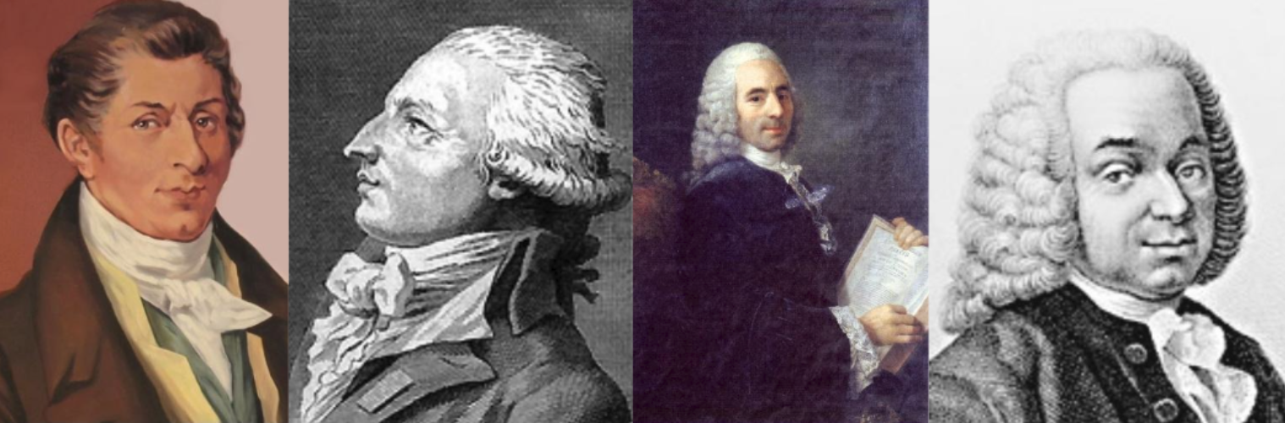

Slide 16


Slide 17
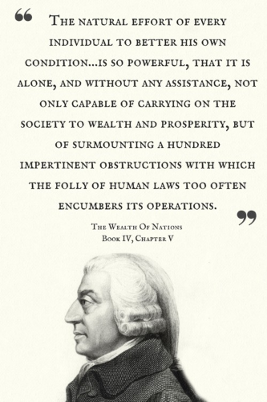
“ The natural effort of every individual to better his own condition … is so powerful, that it is alone, and without any assistance, not only capable of carrying on the society to wealth and prosperity, but of surmounting a hundred impertinent obstructions with which the folly of human laws too often encumbers its operations.”
The Wealth Of Nations
Book IV, Chapter V

Slide 18
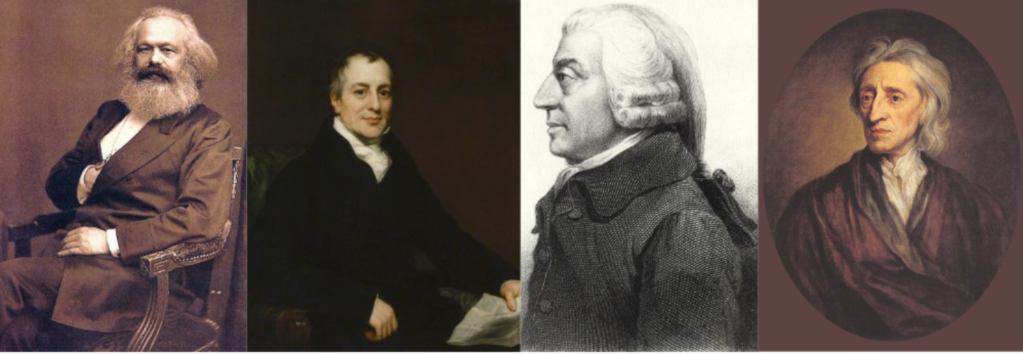

Slide 19
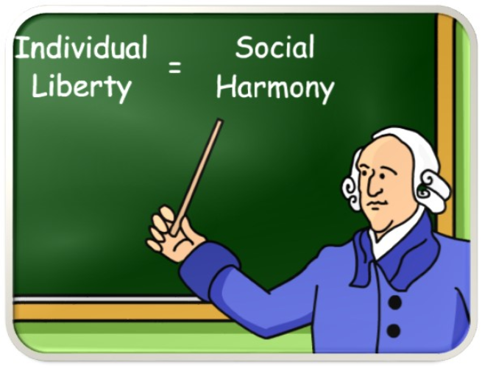
Individual Liberty = Social Harmony

Slide 20
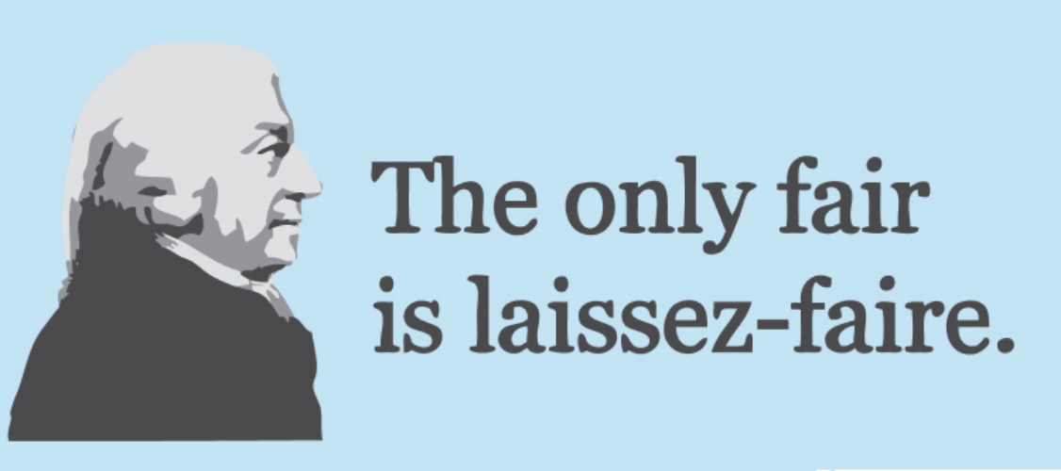
The only fair is laissez-faire.

Slide 21
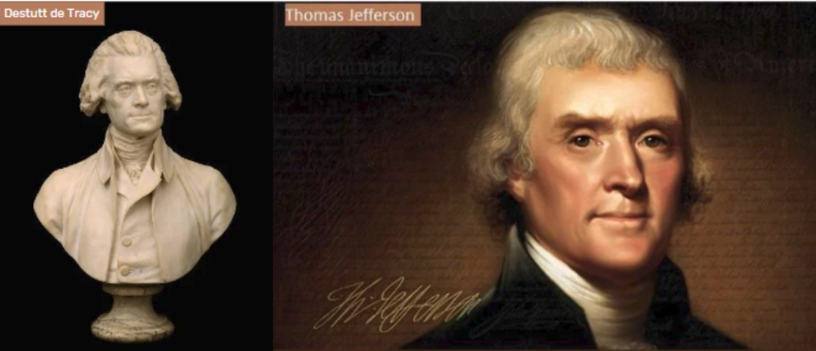

Slide 22
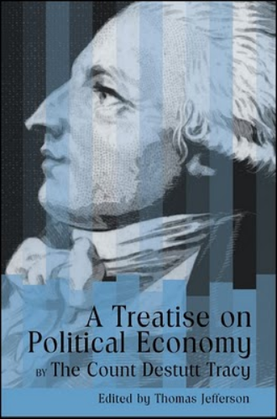

Slide 23
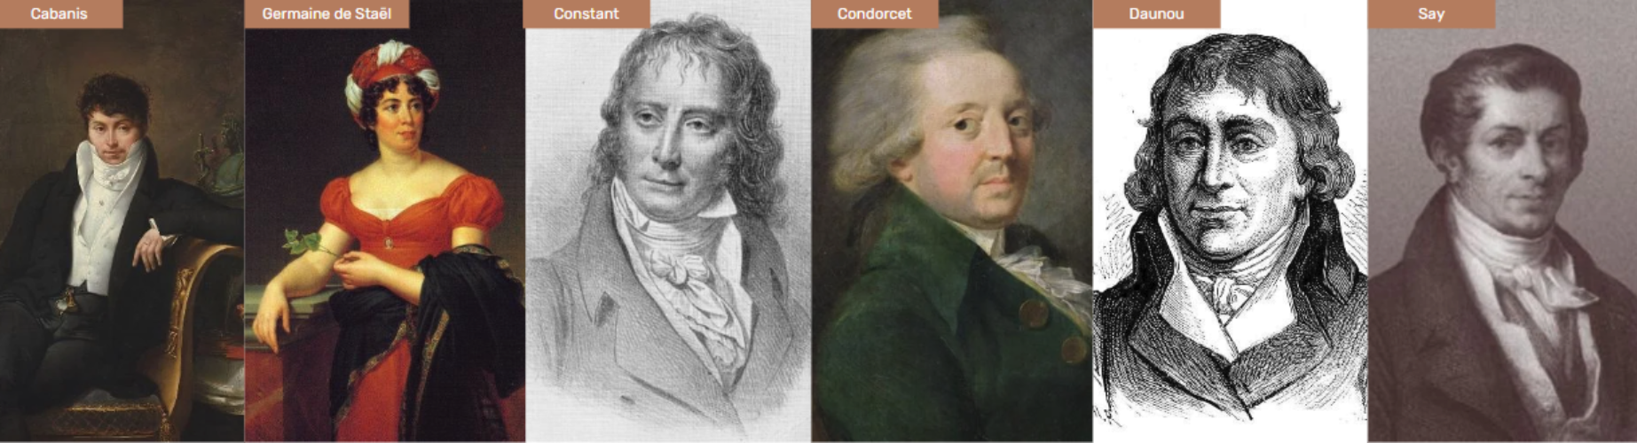

Slide 24


Slide 25
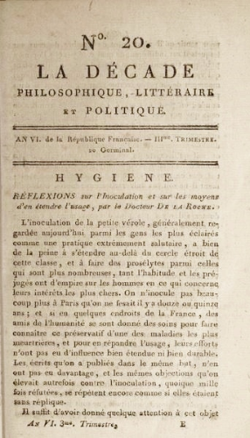

Slide 26
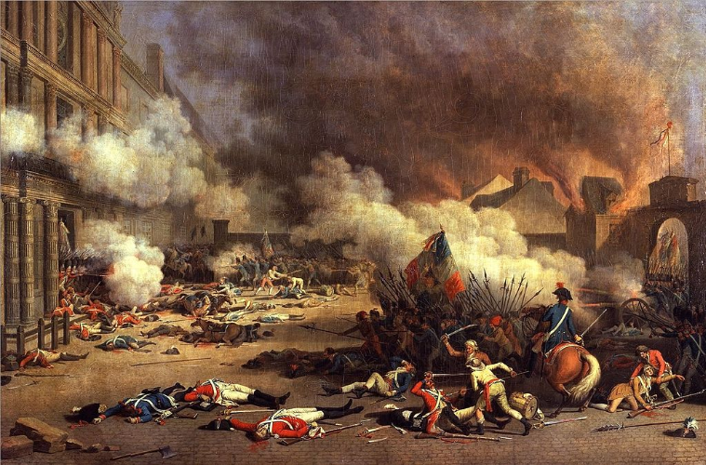

Slide 27
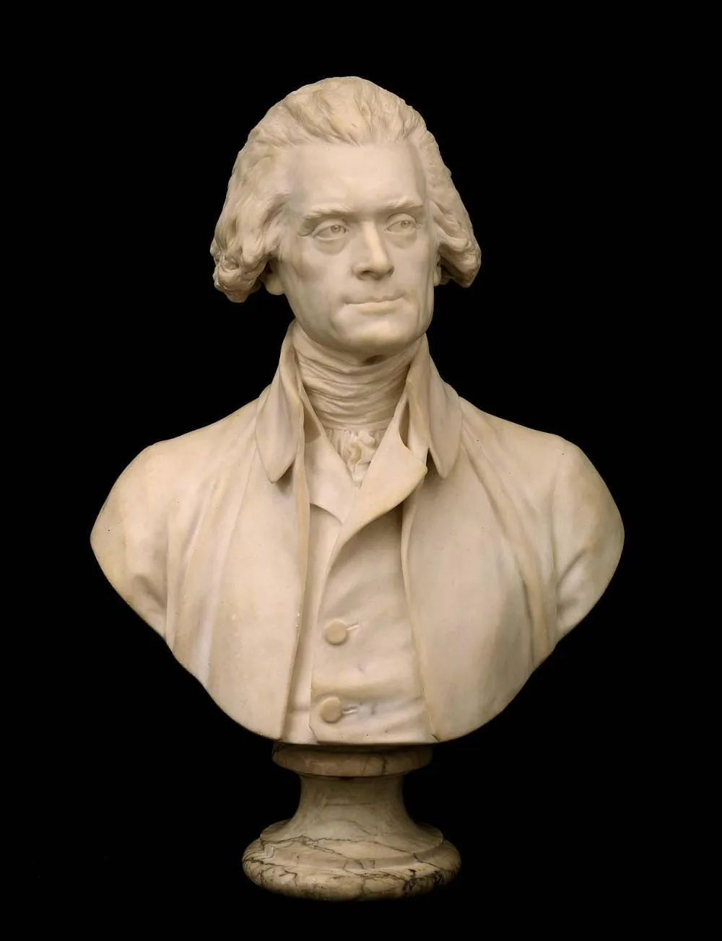

Slide 28
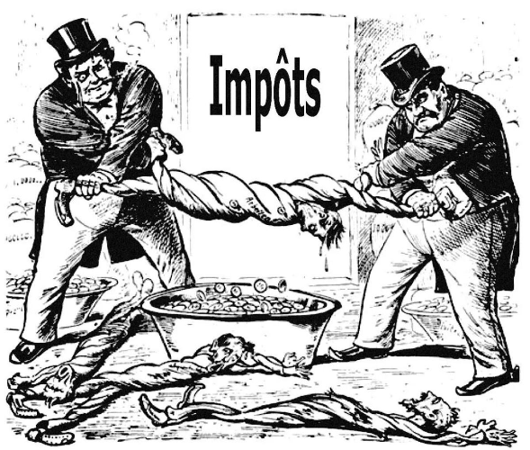
Taxes

Slide 29
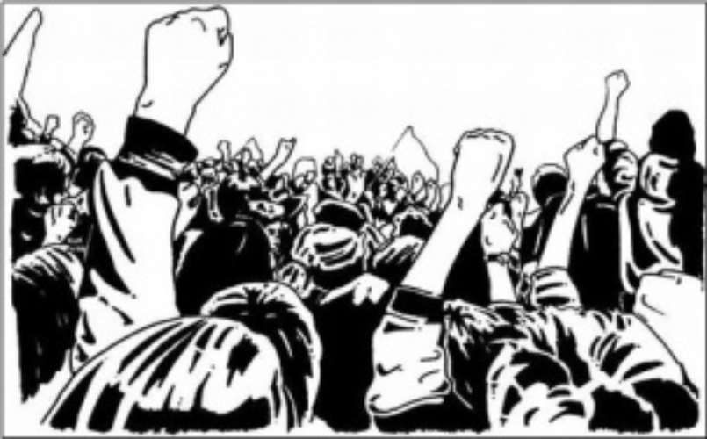

Slide 30
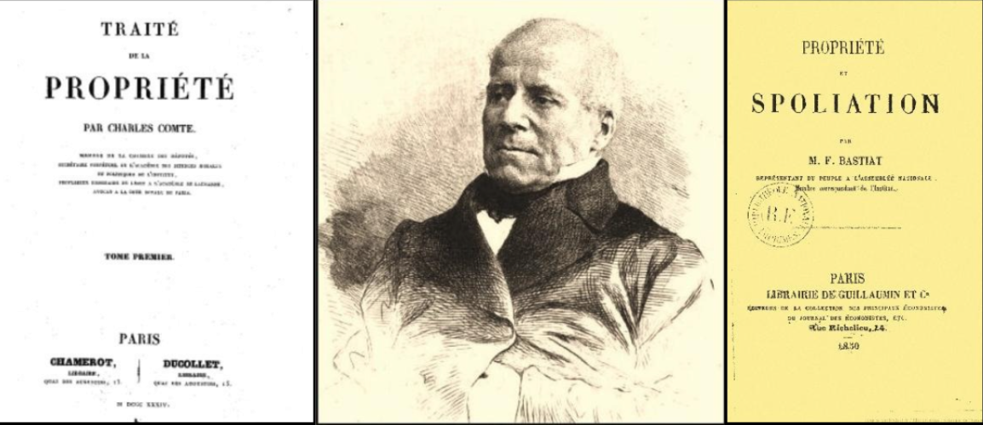

Slide 31
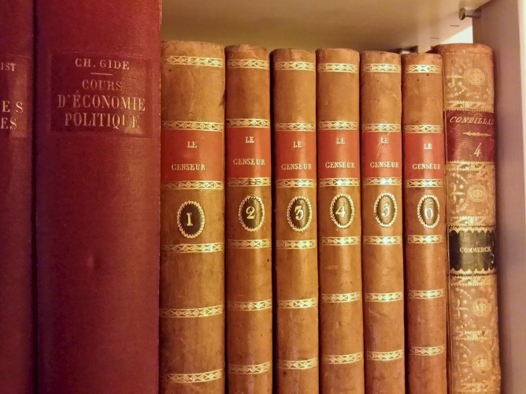

Slide 32
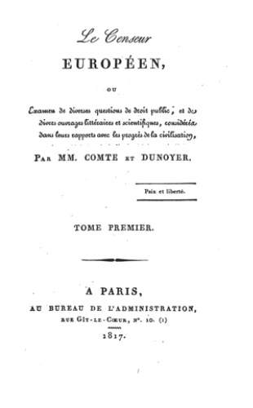

Slide 33
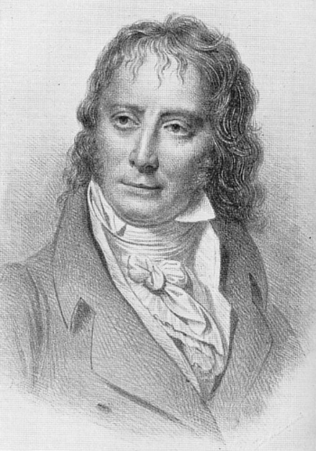

Slide 34
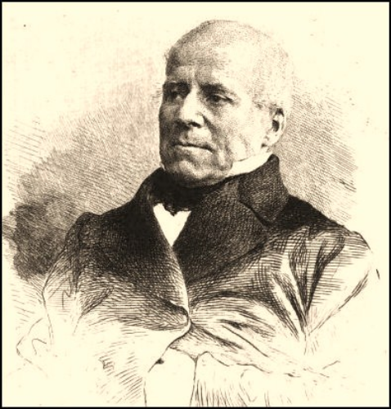

Slide 35
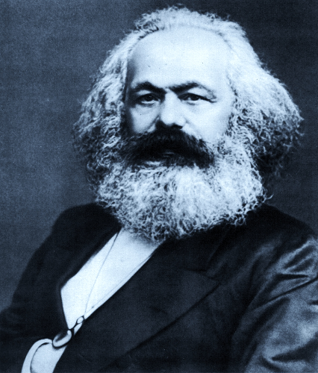

Slide 36


Slide 37
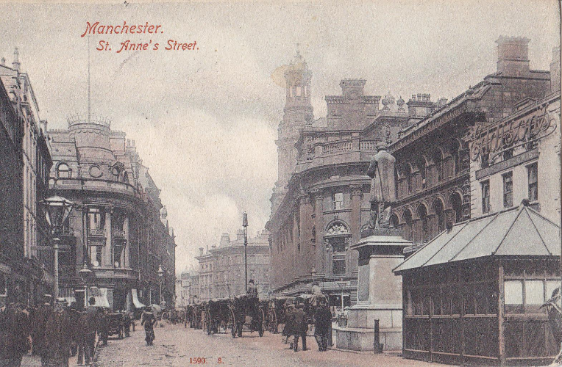

Slide 38
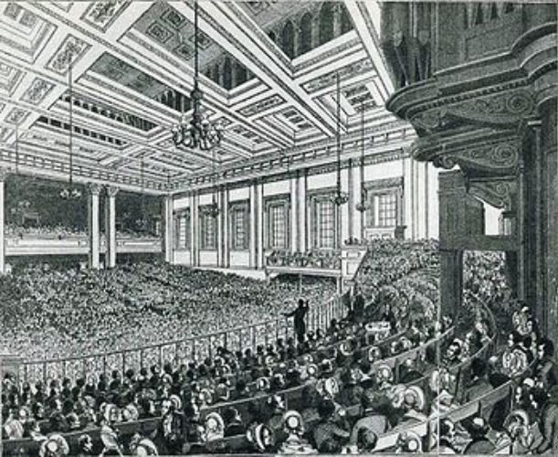

Slide 39
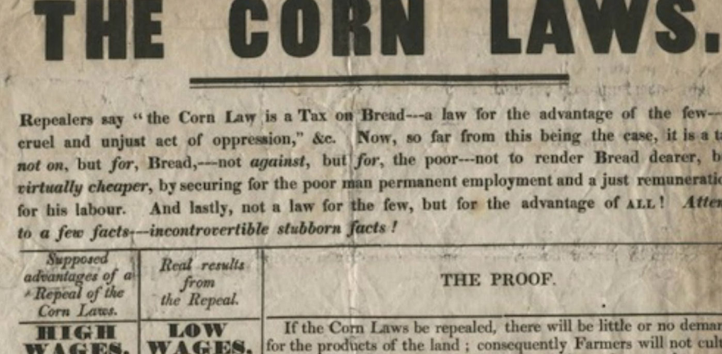

Slide 40
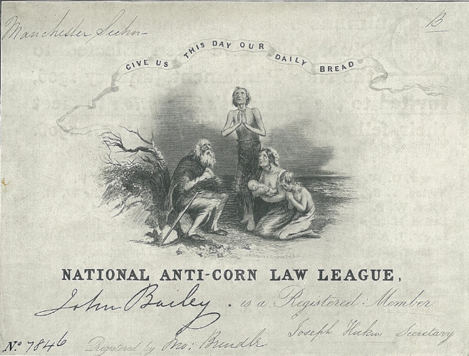

Slide 41
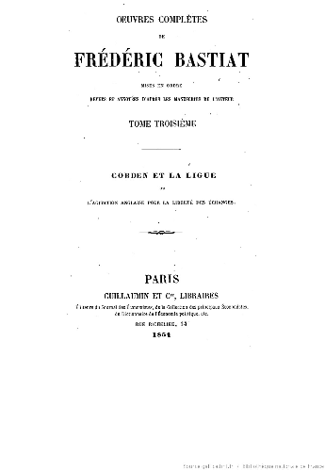

Slide 42
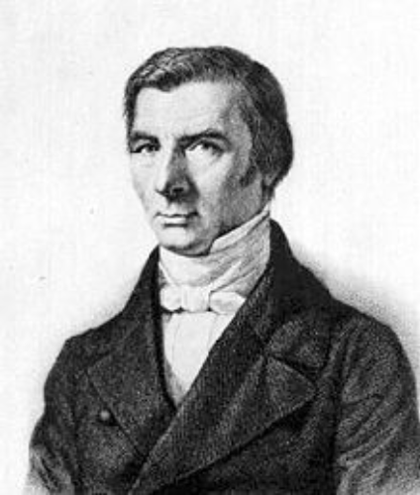

Slide 43
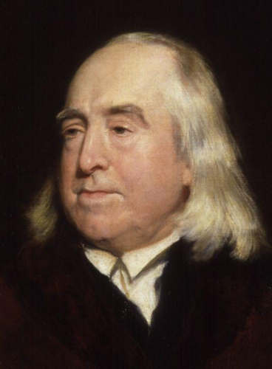

Slide 44
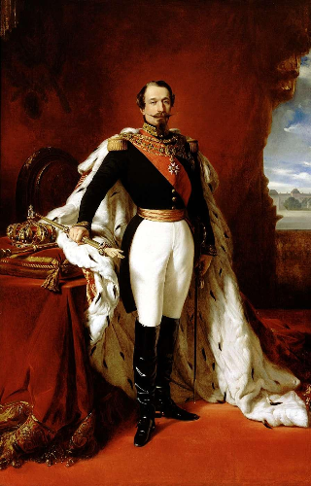

Slide 45
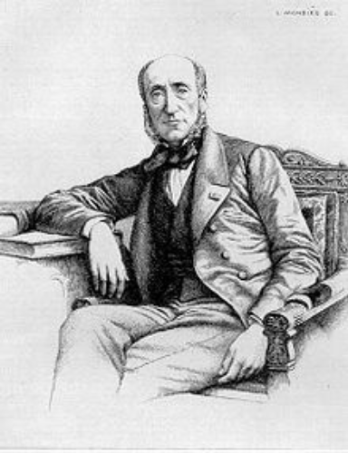

Slide 46
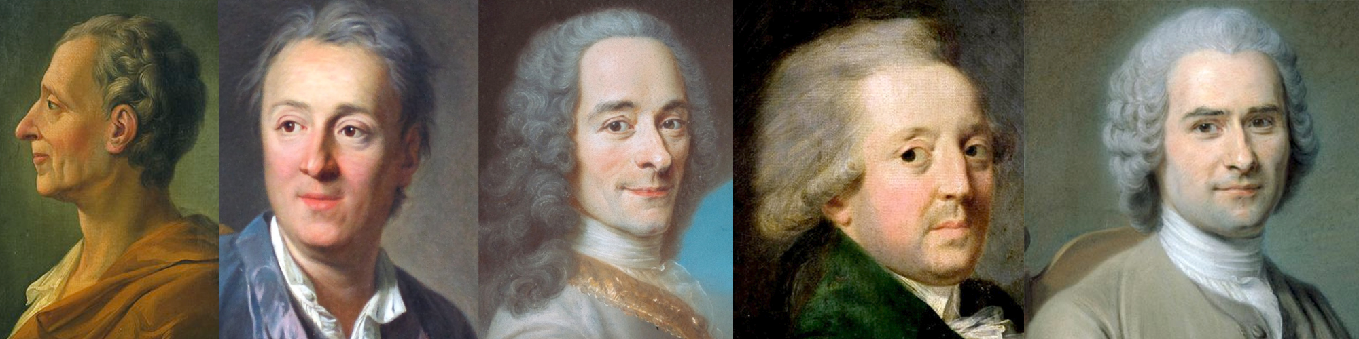

Slide 47


Slide 48
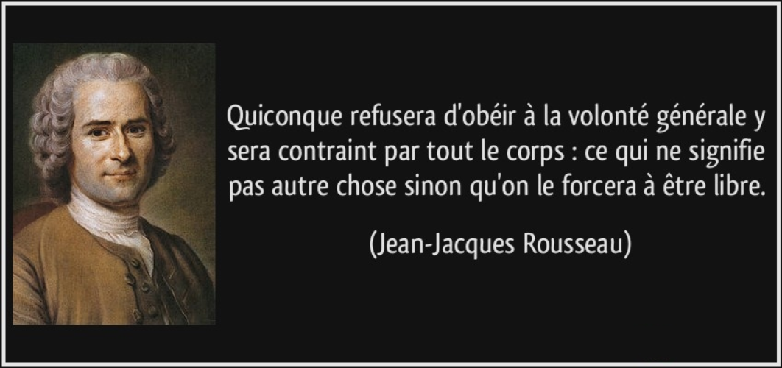
Whoever refuses to obey the general will is going to be compelled to do so by the whole body: which means nothing other than that he will be forced to be free.
Jean-Jacques Rousseau

Slide 49
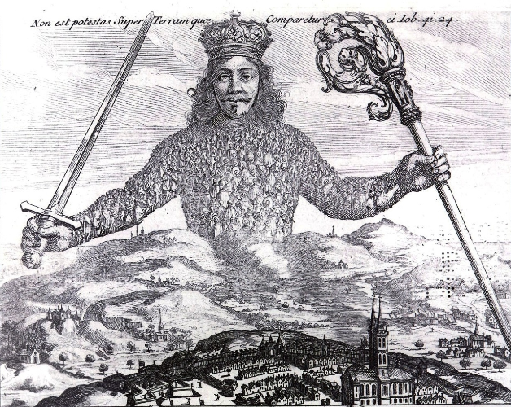

Slide 50
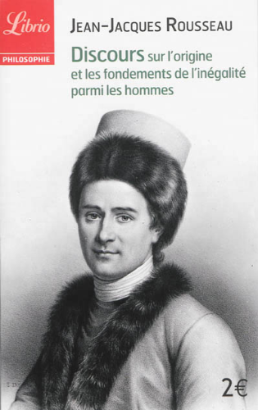

Slide 51
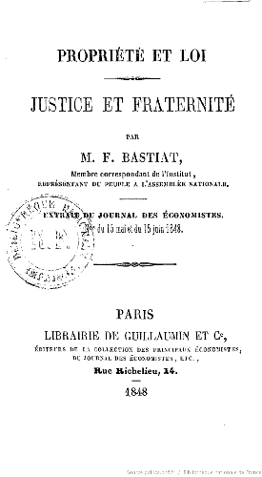

Slide 52
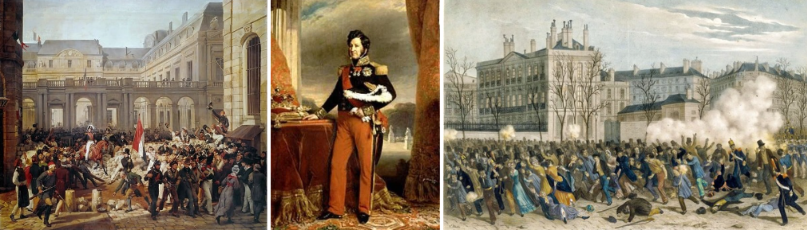

Slide 53
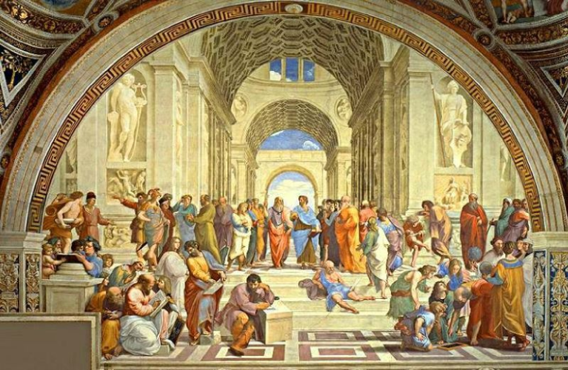

Slide 55
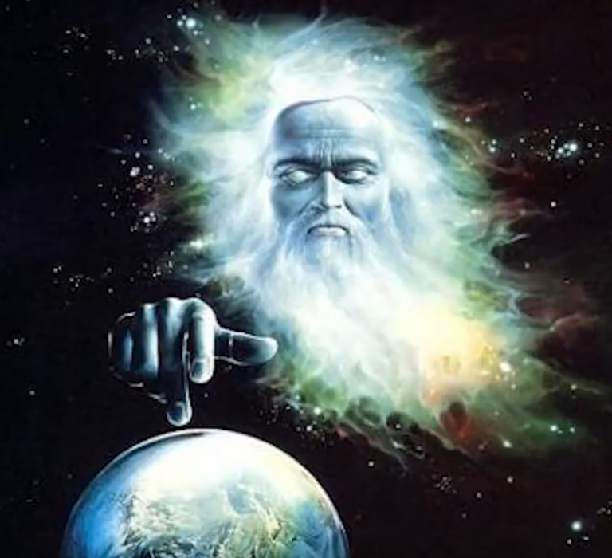

Slide 56


Slide 57
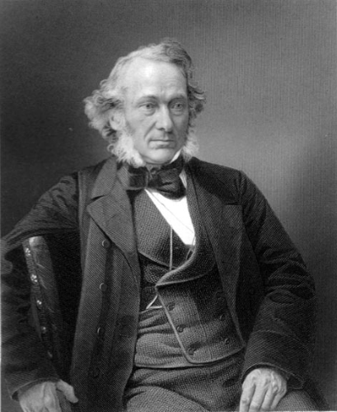

Slide 58
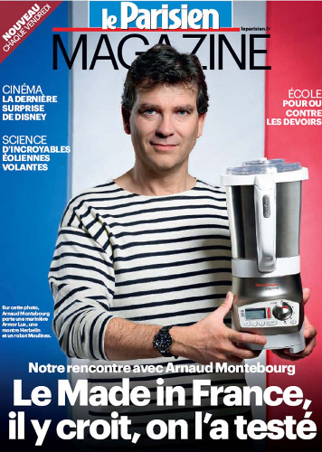

Slide 59


Slide 60

Corporatism
Socialism for big businesses, but capitalism for the poor. A state and corporate partnership of endless debt and war.

Slide 61


Slide 63


Slide 64


Slide 65


Slide 66


Slide 67


Slide 68


Slide 69


Slide 70


Slide 71

Le taux directeur de la BCE
Taux de refinancement, en %
Mario Draghi announced on June 5 the reduction of the main interest rate of the ECB
5 June, 2014
0,15%

Slide 72


Slide 73


Slide 74


Slide 75

Destruction is not profit

Slide 76

DAMN KEYNESIANS

Slide 77


Slide 78


Slide 79

PROTECT OUR CANDLES !

Slide 80


Slide 81


Slide 82


Slide 83


Slide 84


Slide 85


Slide 86


Slide 87

Too much tax kills the tax

Slide 88


Slide 89


Slide 90


Slide 91


Slide 92


Slide 93


Slide 94


Slide 95


Slide 96


Slide 97


Slide 98


Slide 99


Slide 100


Slide 101


Slide 102


Slide 103


Slide 104


Slide 105


Slide 106


Slide 107


Slide 108


Slide 109


Slide 110

To err is human.

Slide 111

Responsibility

Slide 112


Slide 113


Slide 114


Slide 115


Slide 116


Slide 117


Slide 118


Slide 119


Slide 120


Slide 121


Slide 122


Slide 123


Slide 124


Slide 125


Slide 126


Slide 127


Slide 128


Slide 129


Slide 130


Slide 131


Slide 133


Slide 134


Slide 135


Slide 136


Slide 137


Slide 139


Slide 140


Slide 141


Slide 142


